Slide 1


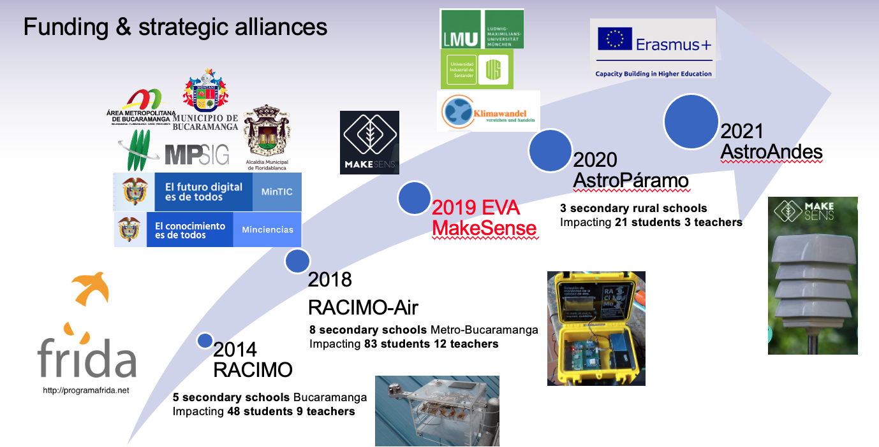
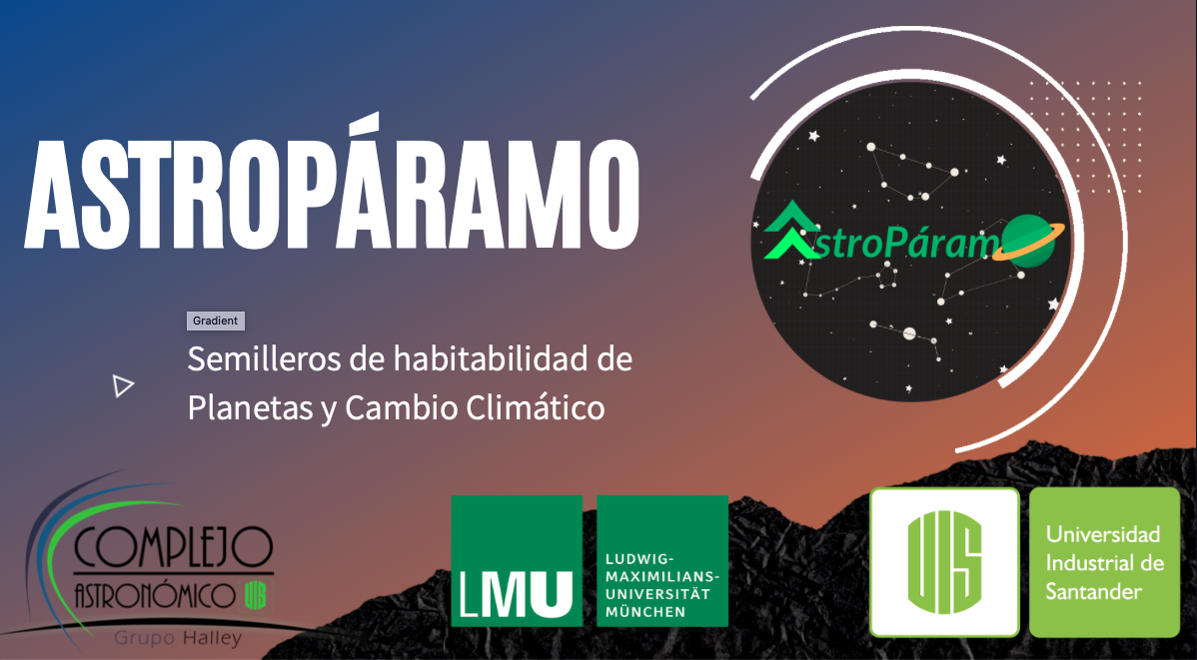
2018 AstroParamo
We use Astrobiology and Climate Change Physics to convince ourselves that the Earth is a very special world in our Galaxy that we must preserve.
https://halley.uis.edu.co/astroparamo/
8

Slide 2
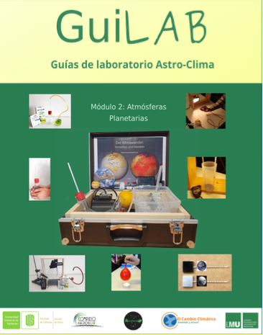
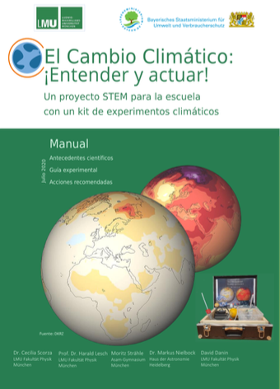
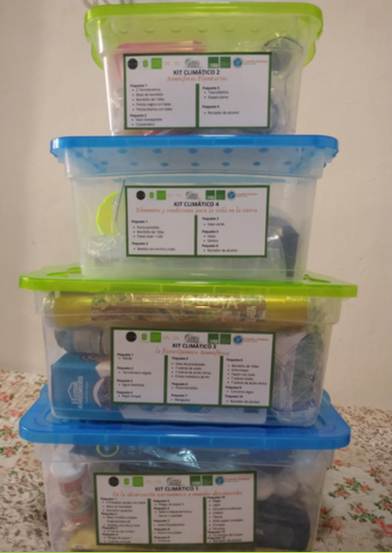
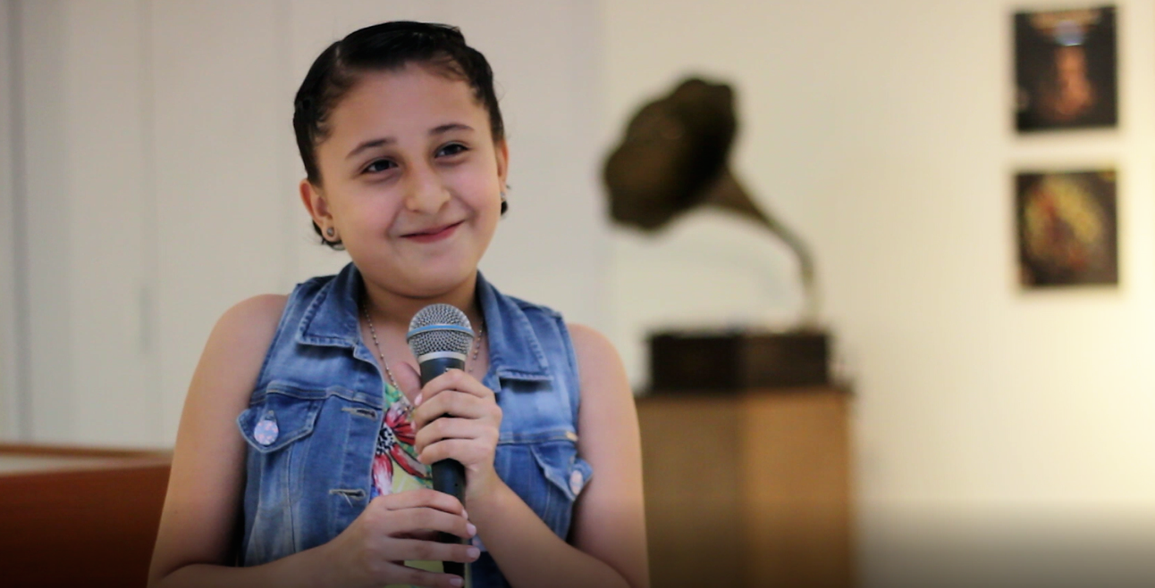
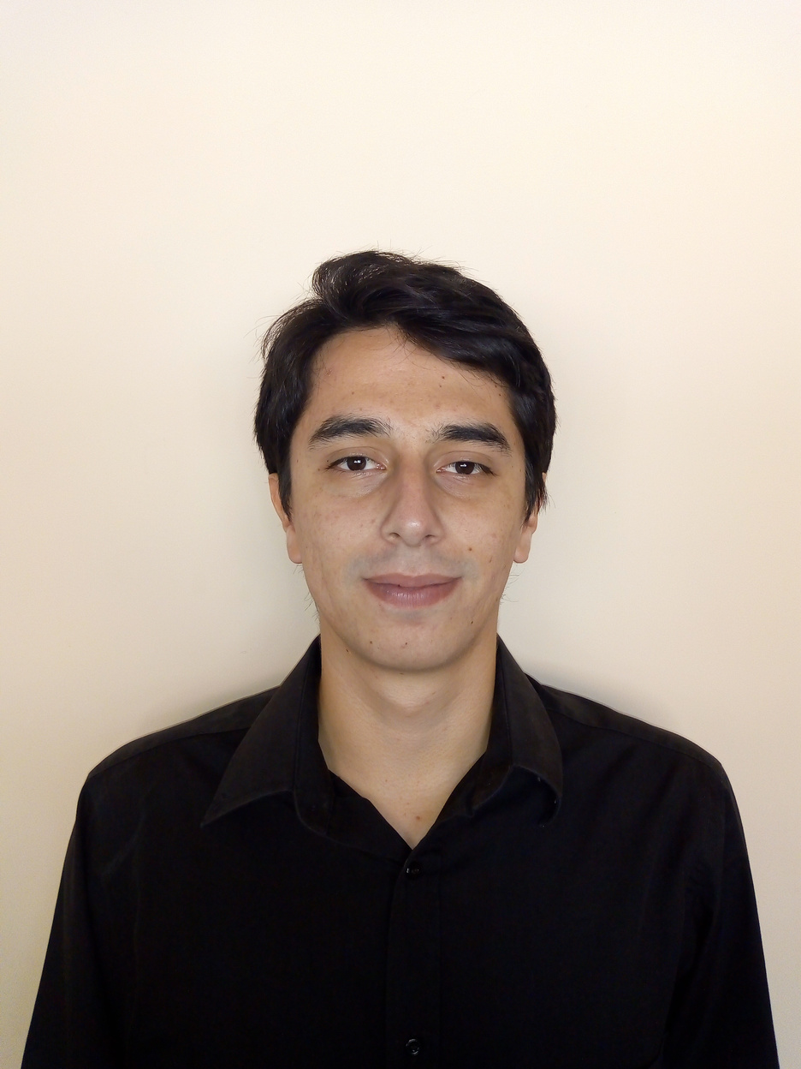
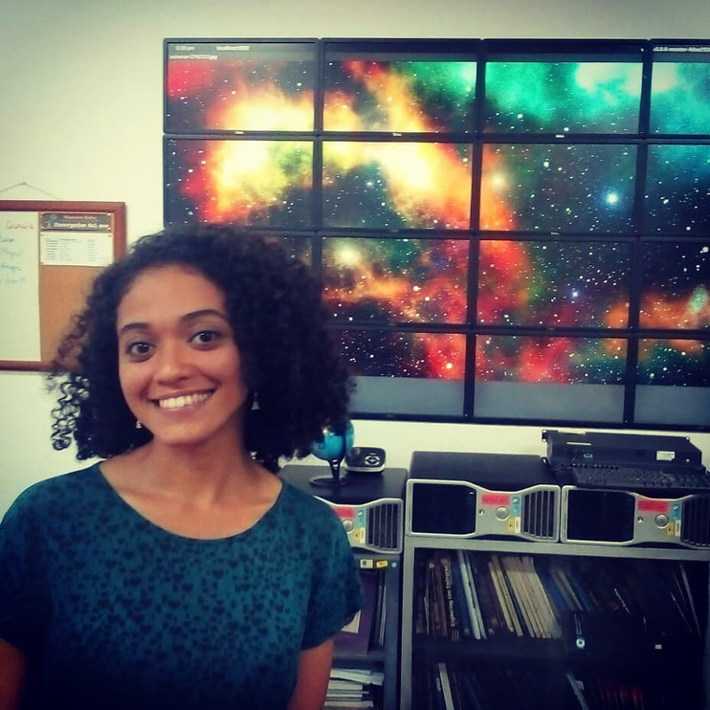
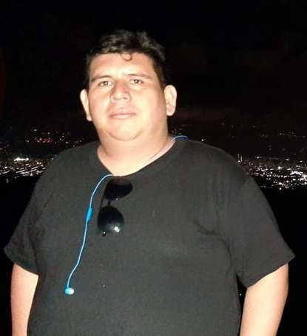
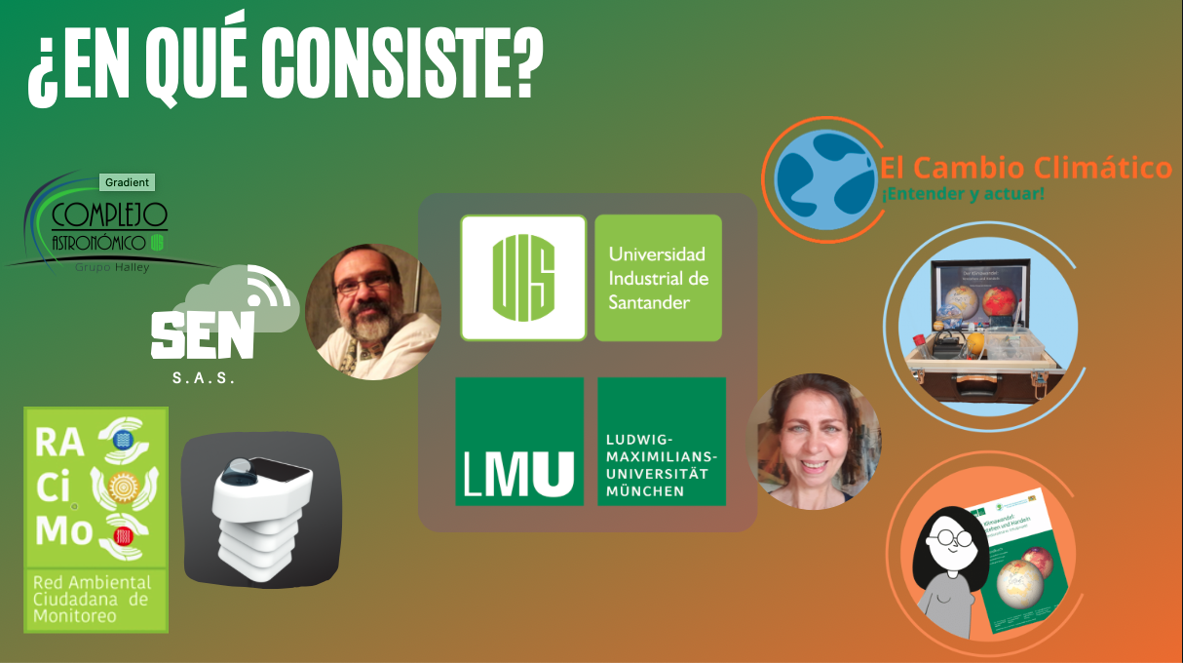
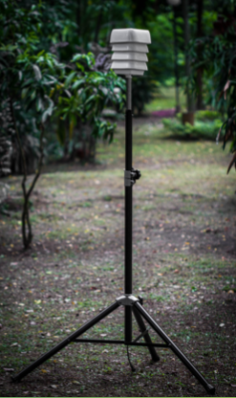


2020 Astropáramo
9

Slide 3
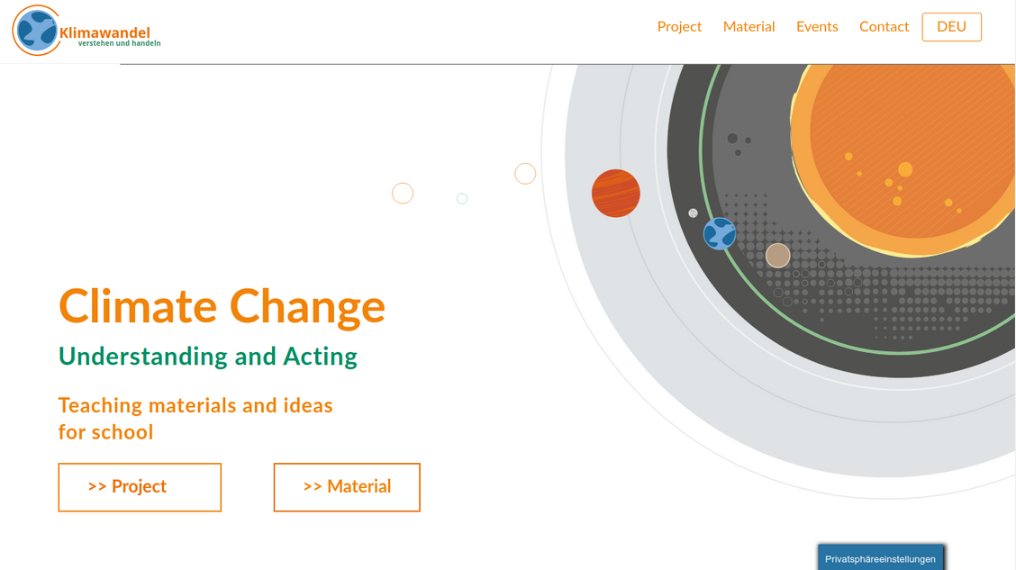

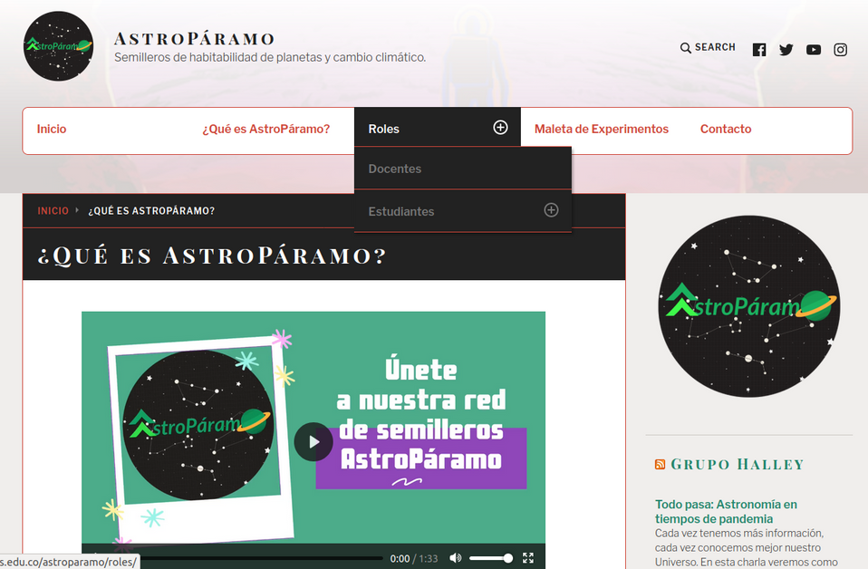

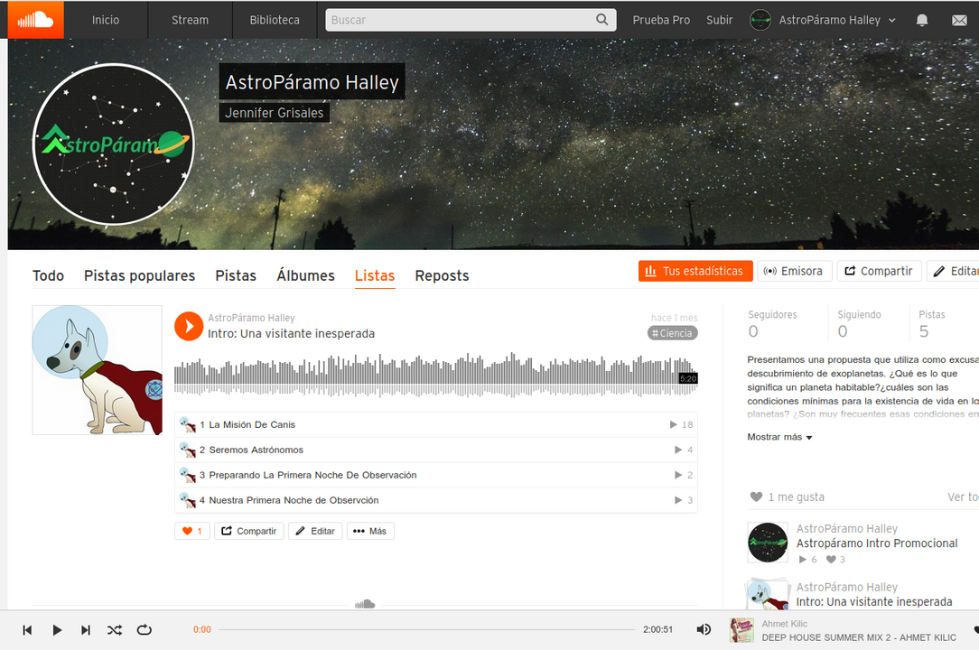


Open Accesss Open Data
https://klimawandel-schule.de/
WEB
https://soundcloud.com/astro-paramo-358723547
PODCAST
https://halley.uis.edu.co/astroparamo
10
http://monitorremoto.herokuapp.com

Slide 4
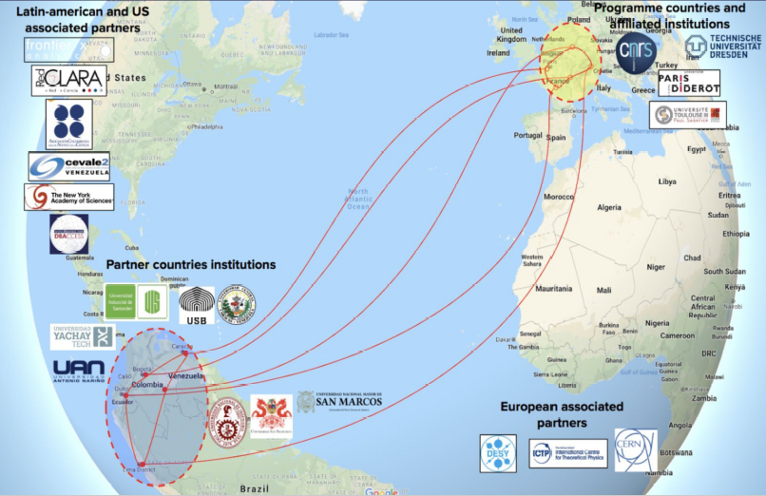
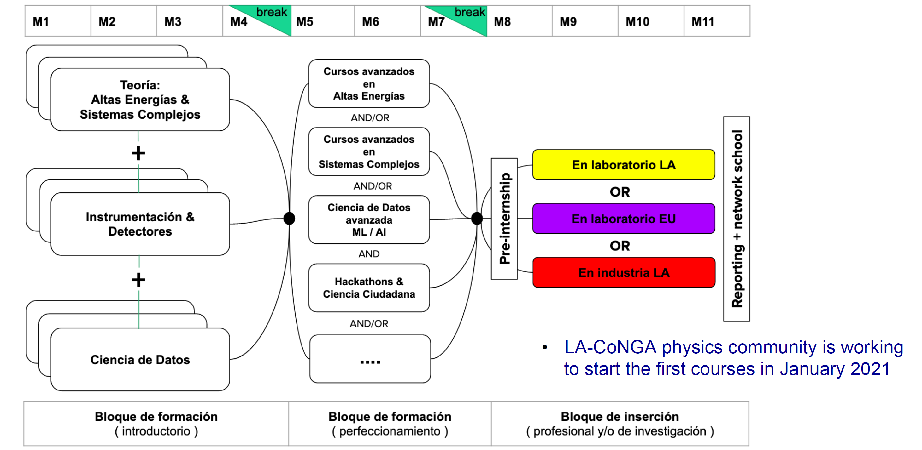
LACoNGA
ERASMUS+ Share Master PROGRAM
Physics program: High Energy + Complex System
11 Universities: 2FR, 1DE, 2PE, 2EC, 2CO 2VE
12

Slide 5
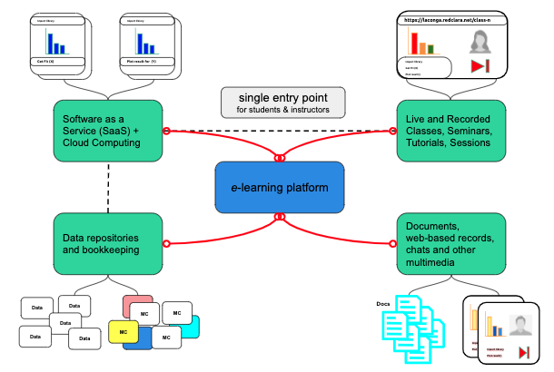

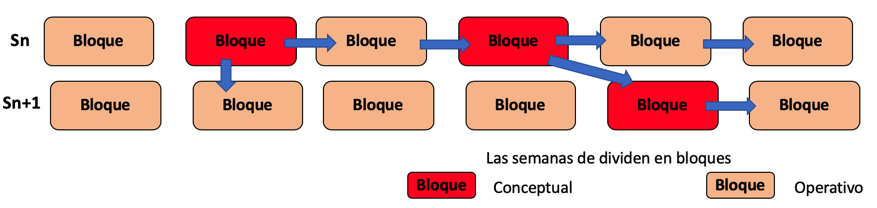
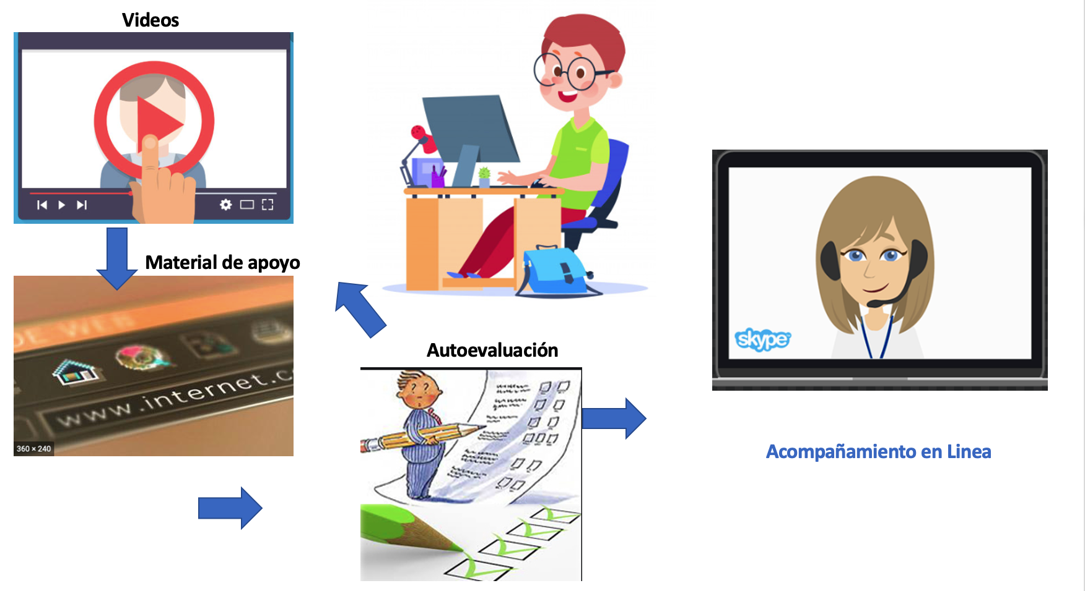

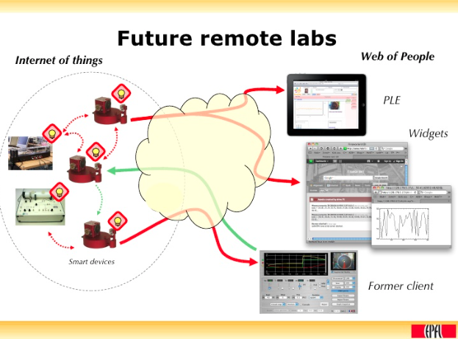
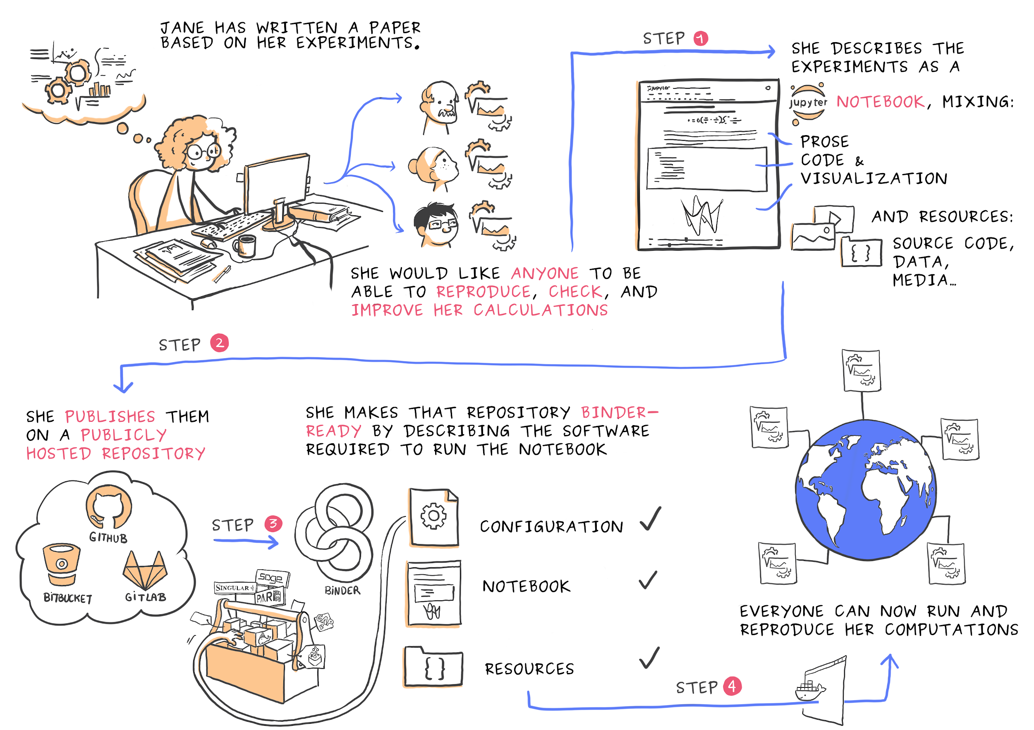
LA-CoNGA physics: Metodology & Plataform
Courses in small blocks
Remote courses lifecycle
Single sing-on
Best practics
Science reproducibility
Remote labs
Standard Plataforms
11

Slide 6

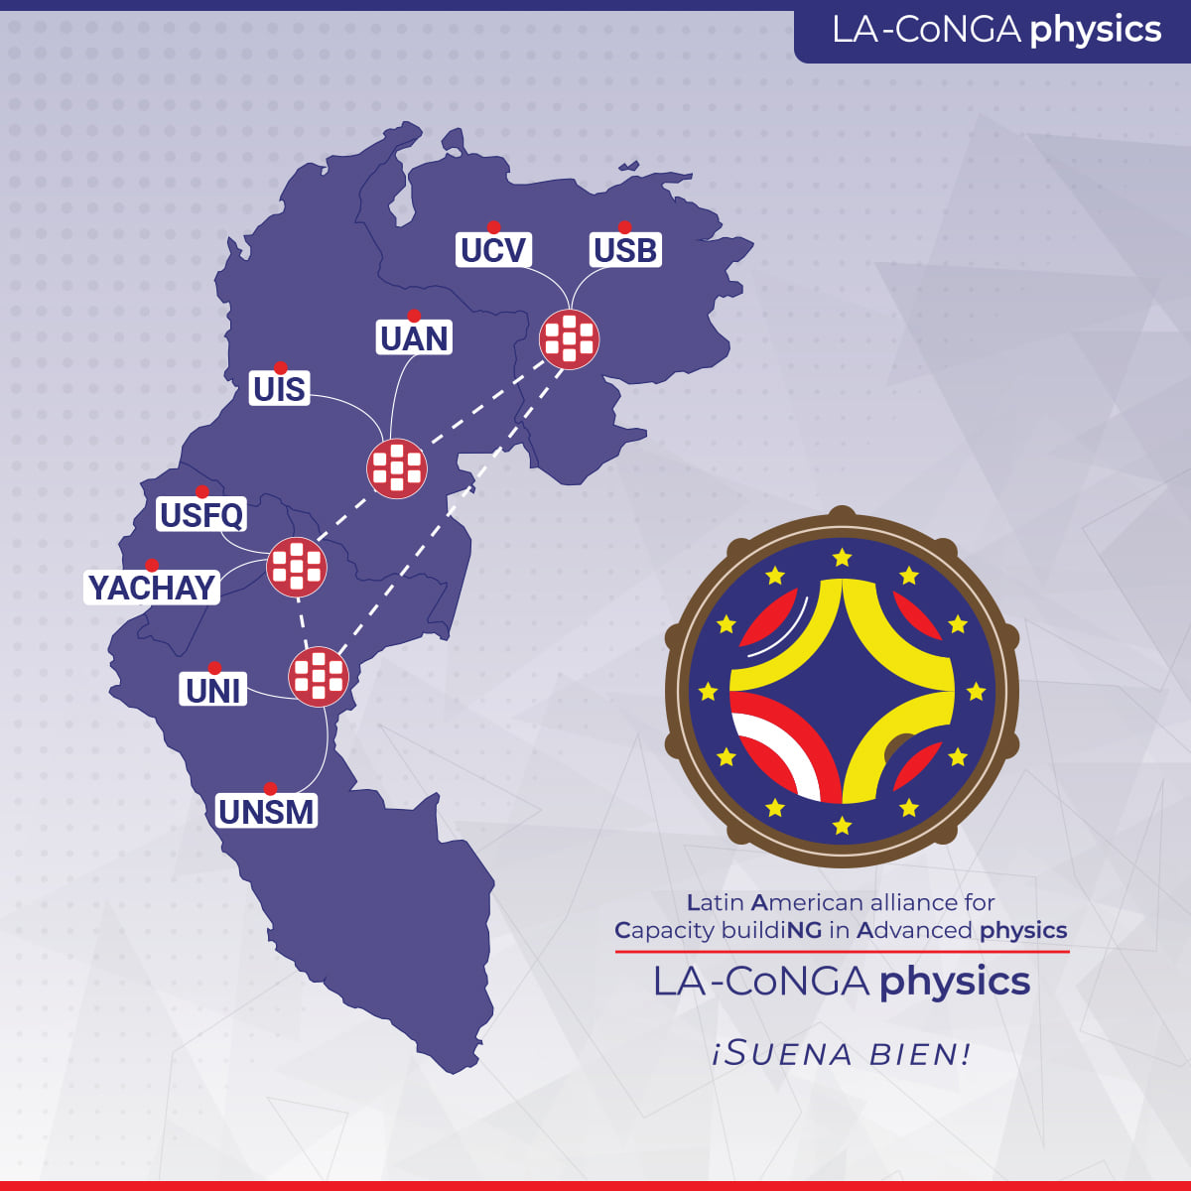
LACoNGA
Each institution will adopt
An school and develop a
Science Club
13

Slide 7


LA-CoNGA physics: ¡suena bien!
LA-CoNGA physics Capacity Building founded by
Erasmus+ Programme
Capacity-Building projects in the field of Higher Education (E+CBHE)
3 years duration
Started January 2020
LA-CoNGA physics ¡Suena bien!
14
Notes:
Reina: nuestro proyecto articula tres ejes de competencia...enmarcado en las iniciativas de construcción de capacidades de la EU. Proyecto cofinanciado por el Erasmus+ EU…
Luis habla de la contrapartida Latam, presenta el proyecto y el video

